Slide 1
Shell Bootcamp 2024 3 Reflections for Week #<>
Anvitha Vadlamudi
Date : 30-Aug-2024

Slide 2

About Me
My Motto: Stay healthy and happy :)

Slide 3

My learnings from this week!

Slide 4
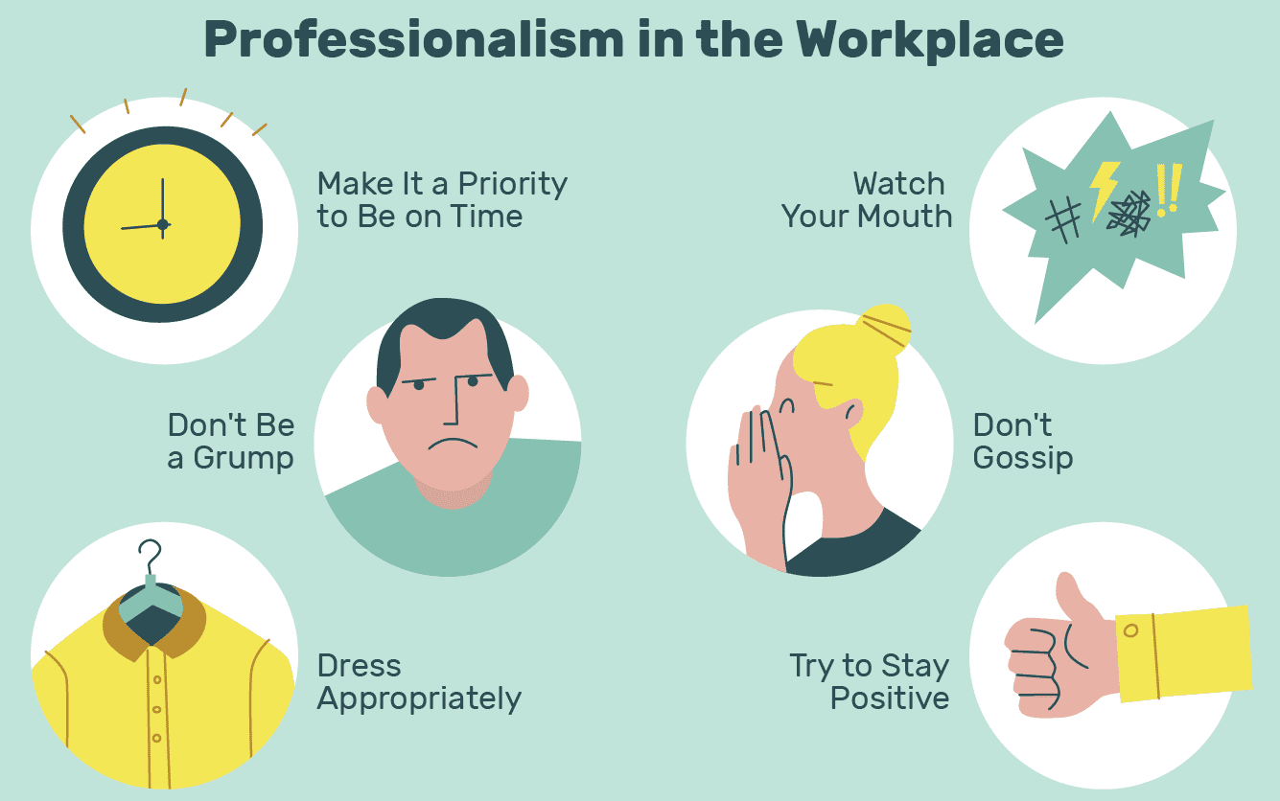
Learning 1 | My takeaways
Key learning: Professionalism in workplace
Key takeaways: Being punctual, no funky hairstyles, no gossiping, dressing appropriately, effective communication, and so on.
How do I personally see this concept implemented in the Energy sector: Irrespective of the sector, being on time, wearing professional attire, and maintaining gossip-free environment is utmost important.

Slide 5
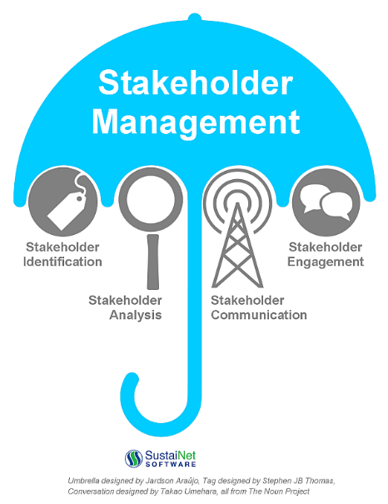
Learning 2 | My takeaways
Key learning: Stakeholder Management
Key takeaways: How to identify, plan, and control stakeholder engagement
How do I personally see this concept implemented in the Energy sector: When company starts a new energy project, it has to deal with government bodies, clients, environmentalists, and customers. Hence, stakeholder management is crucial in this sector.

Slide 6
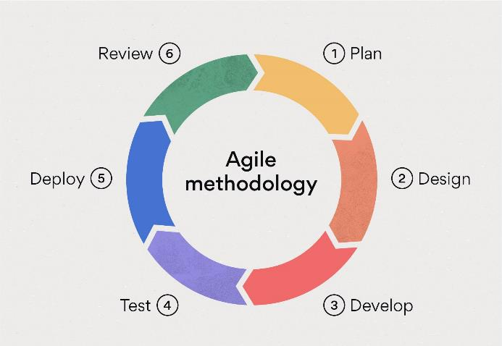
Learning 3 | My takeaways
Key learning: Agile methodology and its types
Key takeaway: I learnt about various new terminologies such as epics, user stories, story points, velocity, retrospectives and so on.
How do I personally see this concept implemented in the Energy sector: Implementing Agile methodology in the energy sector can lead to more efficient project management and provides a better way to address any challenges that arise during projects.

Slide 7

Relevance of learnings for my organization

Slide 8

Learning 1 | Relevance for Shell
Shell implementation of learning: Shell ensures professionalism across workplace by setting clear expectations for employee behavior including punctuality, dressing and grooming.
Shell benefits from this learning: With professionalism, Shell creates positive and productive work environment.

Slide 9
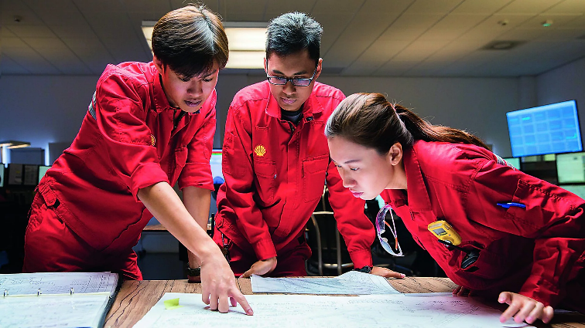
Learning 2 | Relevance for Shell
Shell implementation of learning: Shell implements stakeholder management by actively engaging with various stakeholders such as government bodies, local communities, environmentalists and clients.
Shell benefits from this learning: By using stakeholder management, Shell avoids conflicts and have smoother project execution.

Slide 10
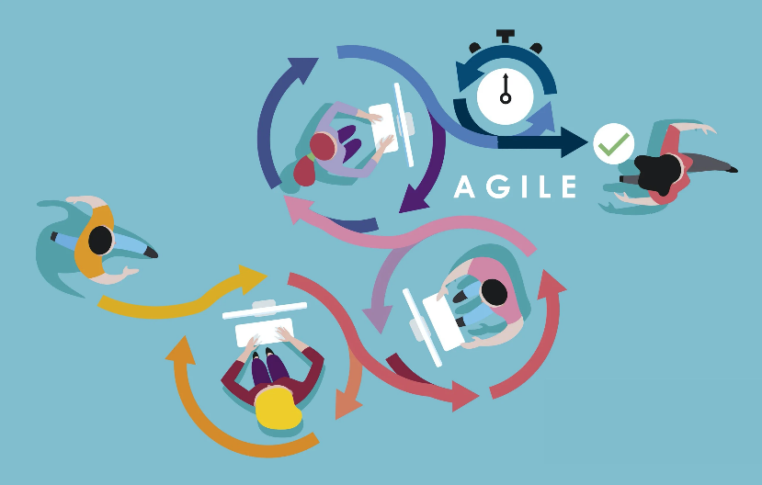
Learning 3 | Relevance for Shell
Shell implementation of learning: Shell uses Agile methodology to manage software development projects. Epics, user stories and sprints helps teams to stay focused.
Shell benefits from this learning: By using Agile, Shell quickly changes to market conditions and project requirements.

Slide 11

Challenges in implementing learning

Slide 12
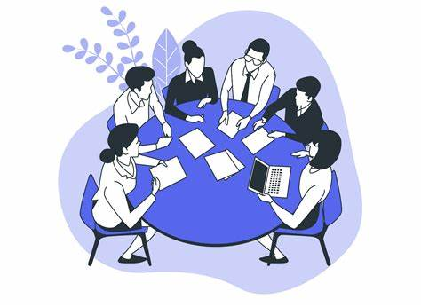
Challenge faced while implementing Learning 1
Learning 1: Professionalism in workplace.
Challenge: Challenge is working with a team that has diverse backgrounds, and different levels of expertise that leads to communication gaps.
Solution: Scheduling regular meetings to keep everyone updated and engaged.

Slide 13

Challenge faced while implementing Learning 2
Learning 2: Stakeholder Management
Challenge: Main challenge that I faced is to align the interests of diverse stakeholders, especially when they have conflicting priorities.
Solution: To overcome this, conducting regular meetings and by having transparent communication we can have a balancing environment.

Slide 14
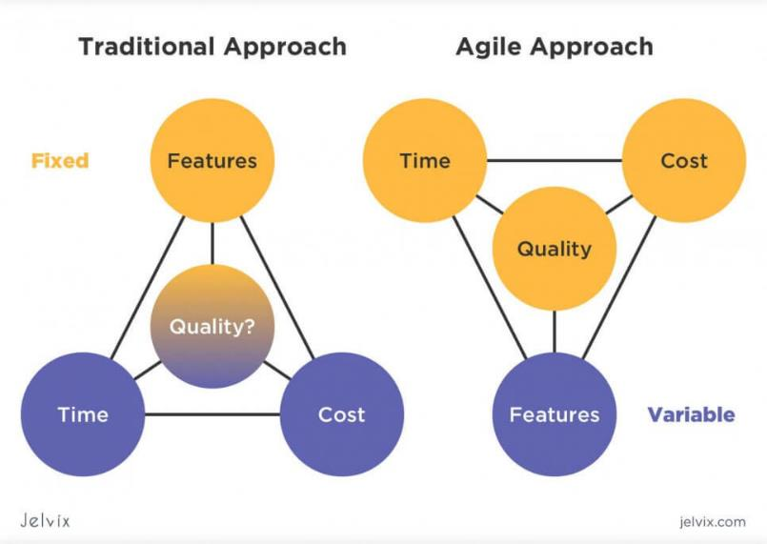
Challenge faced while implementing Learning 3
Learning 3: Agile methodology and its types
Challenge: Adapting from rigid project structure to iterative nature of Agile.
Solution: To overcome this, taking hands-on sessions will make me feel more comfortable with Agile principles.

Slide 15

Action Plan

Slide 16
My Action Plan for this Week
Actions
Timeline
Status
Being punctual
Creating user stories, epics, sprints, story points, burndown charts in Azure DevOps
Networking
As long as I, work for this company
Before the pre-assessment
3 months
Mostly punctual
Familiarized with user stories, epics, sprints, and story points
Trying to connect with my fellow colleagues

Slide 17

Learning is also Fun!

Slide 18
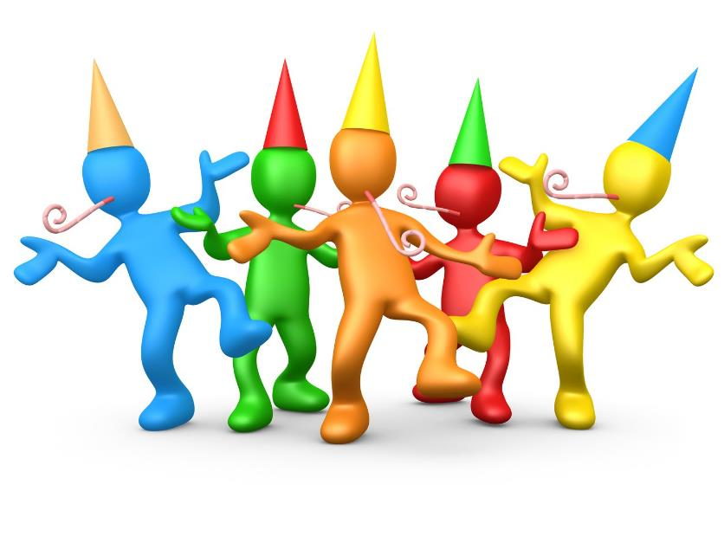
Learning is also Fun!
Please share how ”Your” learning was fun this week
As part of soft skills training, we were asked to choose a topic of our choice for group presentation. The topic we chose is “House Party”. While preparing the presentation we shared about our own house party experiences. This helped us to bond as a team also revealed funny incidents happened during our parties.

Slide 19

Summary
Quick Summary: In this week, training sessions covered many topics starting from professionalism in workplace, role plays, stakeholder management, team presentation, etiquettes, dressing and grooming to Business Analytics, Software Development Life Cycle, Waterfall Model, Agile methodology, and Azure DevOps.
Importance of topics of upcoming week: In the upcoming week we’ll focus on Software testing, DevOps, Cloud, and DBMS. By covering these topics, we’ll get foundational knowledge on all aspects which is very crucial for teamwork and successful project execution.
Connectivity of topics from current week: The topics from this week, such as Software Development Life Cycle is the basis while doing any project. Agile is an iterative process which is particularly relevant as our company uses it for smoother execution of projects.

Slide 20
Thank You

